Slide 1


Slide 2

Beauty and Cosmetic Surgery
Instructor: Nguyen Ngoc Tram(Ms)
Class: EN12307_1
Student code: PS05854 & PS05845
Name: Nguyen Duc Thanh Tam & Tran Anh Vu

Slide 3

Out Line
Introduction
Personal-care
Do exercise
Yourseft
My Daily routine
Conclusion

Slide 4
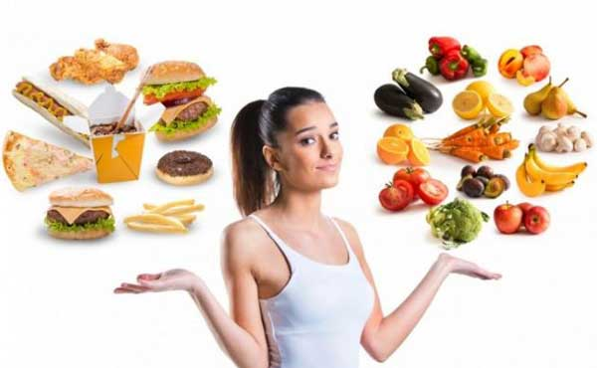
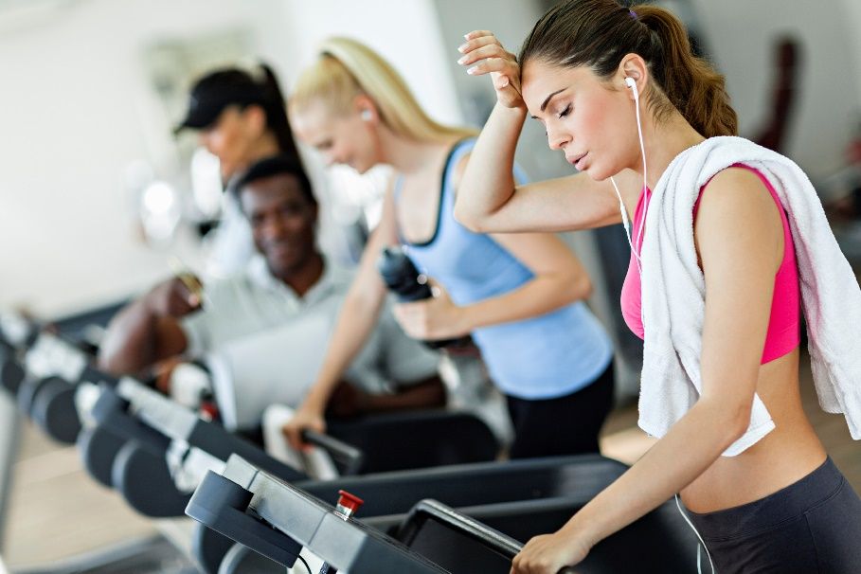
First of all
Eating habit
Do exercise

Slide 5
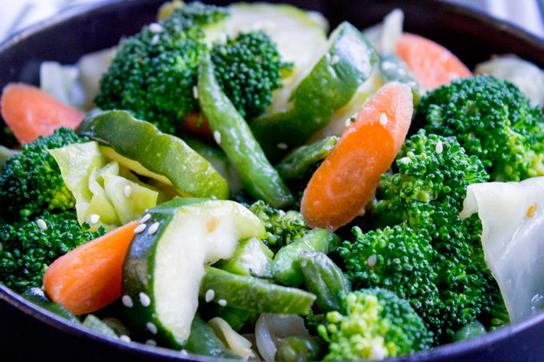
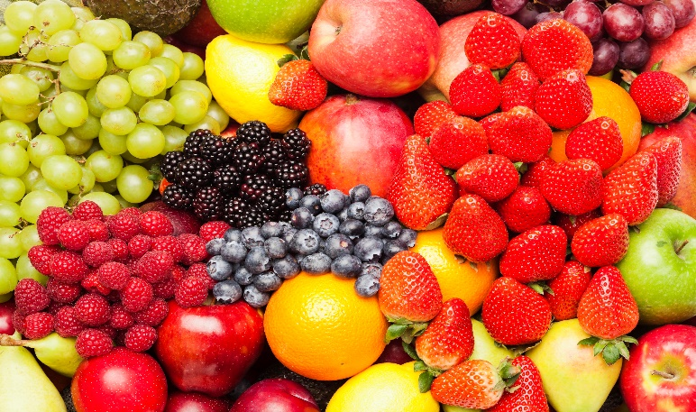
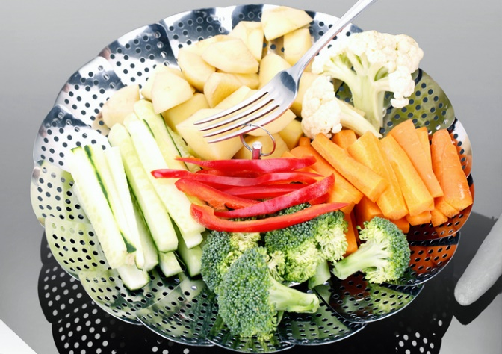
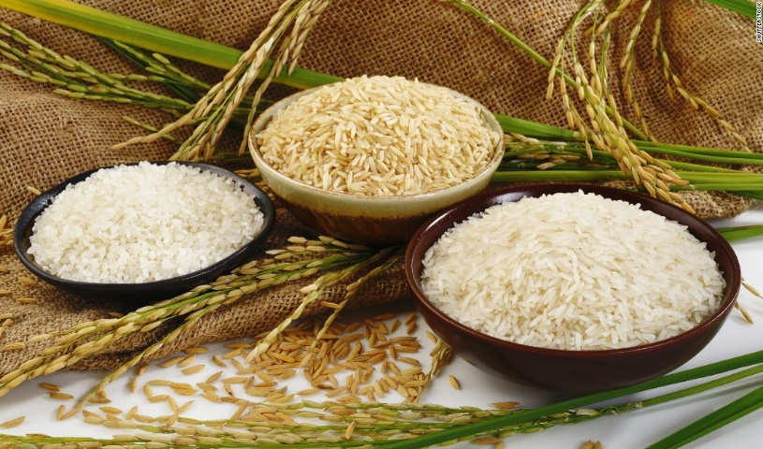
Good for Healthy
Mixed vegatables
Fruits
Boiler vagatables
Rice

Slide 6
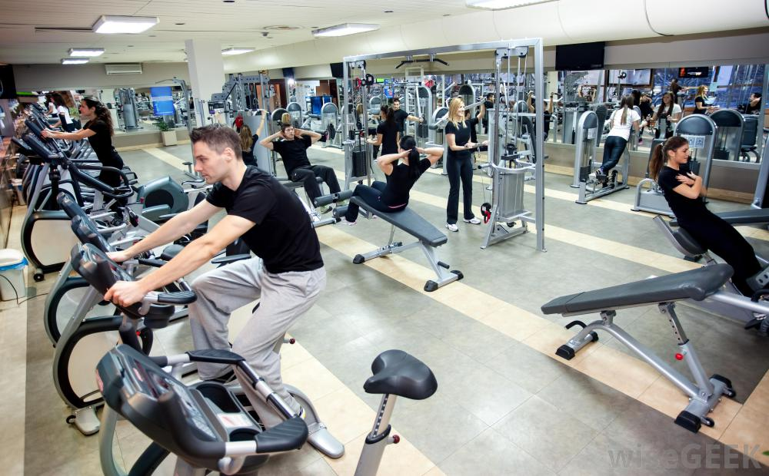

Activity
Gymnastics
Play sports

Slide 7
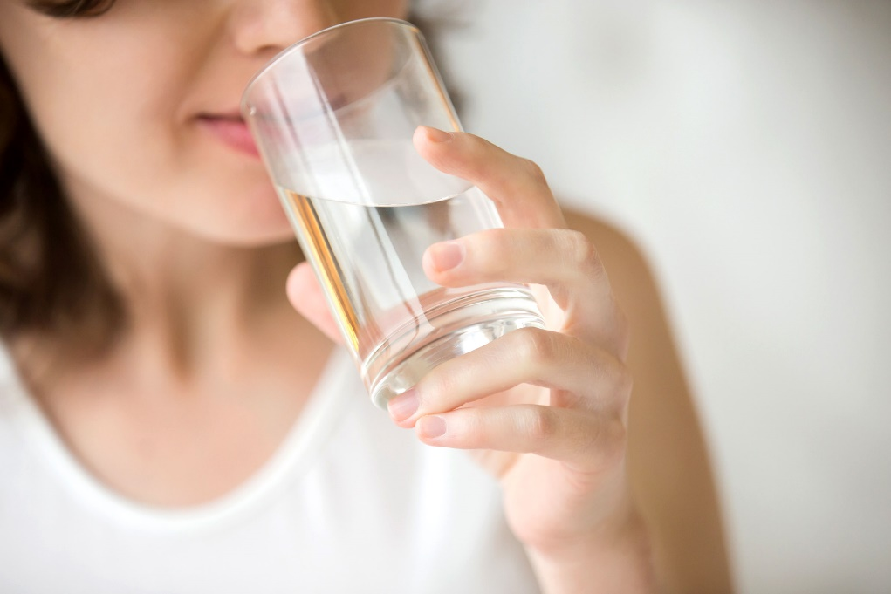
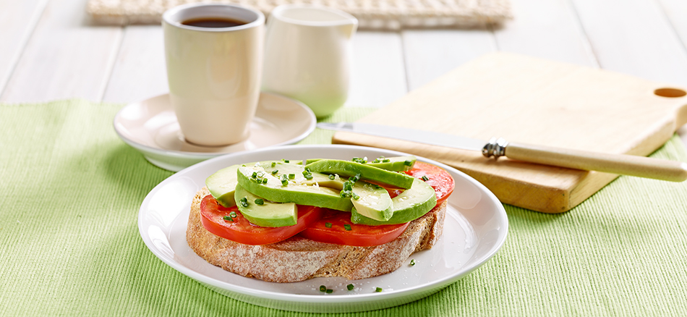
Good habit
Least 2liter/day
Alway eat breakfast

Slide 8

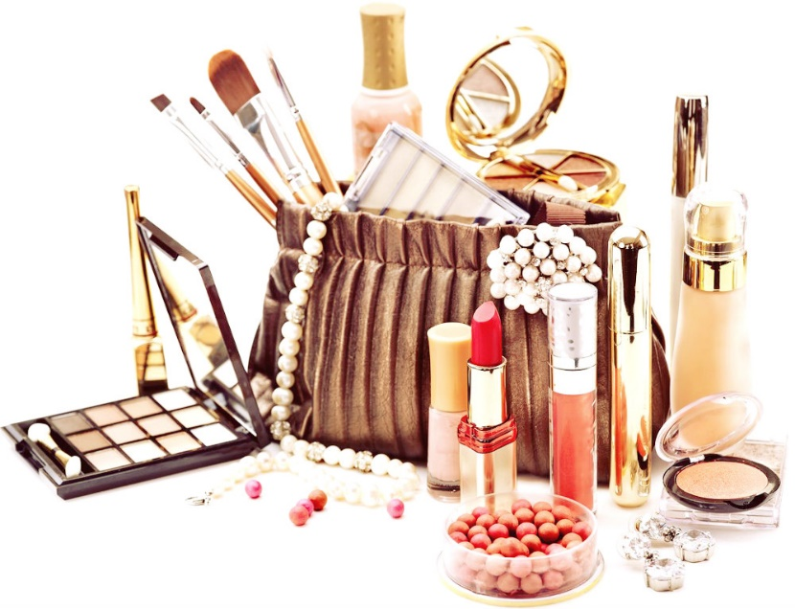
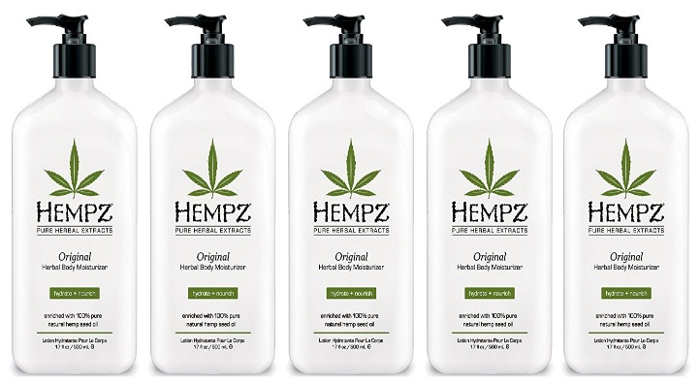
Personal-care products
Cleanser
Cosmetic
Lotion

Slide 9
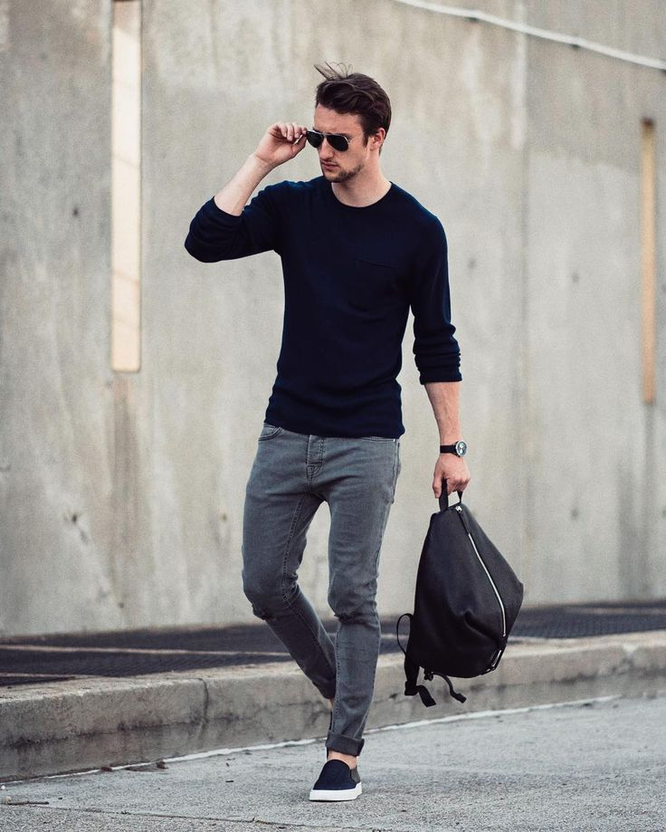
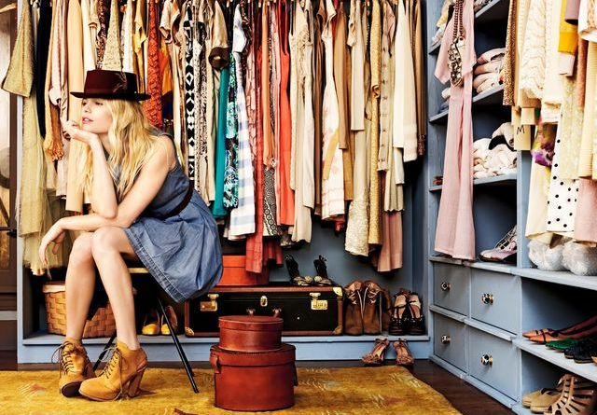
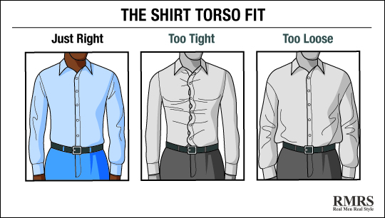
Appearance
Choose clothes
Fashion style
Fit & Suitable

Slide 10
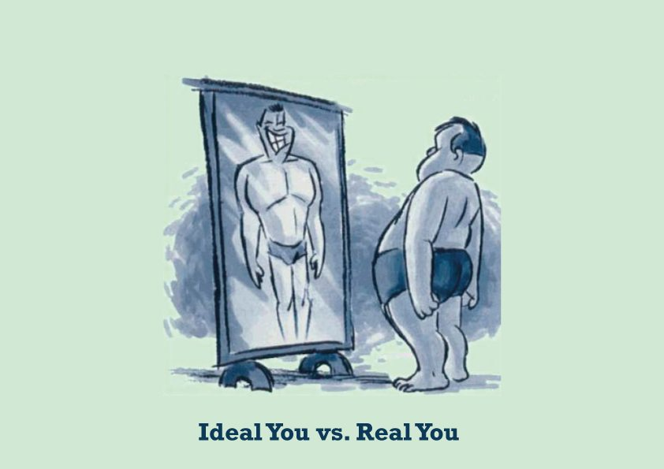


Conclusion
You look
Believe youselt
Identify

Slide 11
Thanks for listening

